Slide 1
WAITS IN SELENIUM

Slide 2
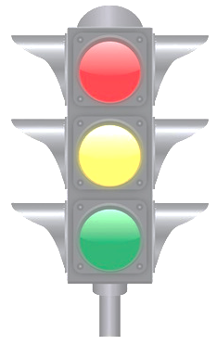
WAITS IN SELENIUM
WAITS IN SELENIUM
IMPLICIT
WAIT
EXPLICIT
WAIT
<number> / 7

Slide 3
WAITS IN SELENIUM
Implicit Wait
An implicit wait is to tell WebDriver to poll the DOM for a certain amount of time when trying to find an element or elements if they are not immediately available. The default setting is 0. Once set, the implicit wait is set for the life of the WebDriver object instance.
Example:
  driver.manage().timeouts().implicitlyWait(timeOut, TimeUnit.SECONDS);
  driver.manage().timeouts().implicitlyWait(timeOut, TimeUnit.MILLISECONDS);
<number> / 7

Slide 4
WAITS IN SELENIUM
Explicit Wait
Thread.Sleep():
Example: Thread.Sleep(2000);
Is not a wise choice as it suspends the current thread for the specified amount of time.
You can never be sure about the exact wait time. So, your test will fail if the element won't show up within the wait time.
After the time 't' reached, the current thread will move from the waiting queue to the ready queue, and then it takes some time to be picked by the CPU and be running.
<number> / 7

Slide 5
WAITS IN SELENIUM
Explicit Wait
For when a locator cannot identify a new element, Selenium comes with an integrated Explicit Wait where you can specify an amount of time to wait for a process before automating a command.
This should help give the page or particular object enough time to load and identify the element to interact with.
Example :
WebDriverWait wait = new WebDriverWait(driver, 10);
wait.until(ExpectedConditions.presenceOfElementLocated(locator));
<number> / 7

Slide 6
WAITS IN SELENIUM
Explicit Wait
presenceOfElementLocated – This defines an expectation of identifying an element at the DOM level, such as recognizing that the button exists on the page.
visibilityOfElementLocated – This defines an expectation of identifying an element is present at the DOM level and visible so that the button is there and the user could see it.
visibilityOfAllElementsLocated – This checks that all elements are identified and visible, such as a button and an image.
elementToBeClickable – This defines an expectation to check for a visible element and click it, such as clicking a button.
<number> / 7

Slide 7
it is time to test…
Test Case :
  Go to https://www.google.com/maps
  Search for CyberTek
  Get directions
<number> / 7

Slide 8
WAITS IN SELENIUM
QUESTIONS ?

Slide 9
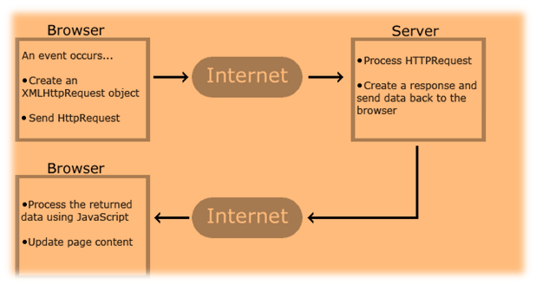
AJAX
AJAX stands for Asynchronous JavaScript & XML, and it allows the Web page to retrieve small amounts of data from the server without reloading the entire page.
For example, when you click on submit button, JavaScript will make a request to the server, interpret the result and update the current screen without reloading the webpage.
When you are checking the content or the element to be displayed , you need to wait till you get the response. During AJAX call the data is stored in XML format and retrieved from the server.

Slide 10
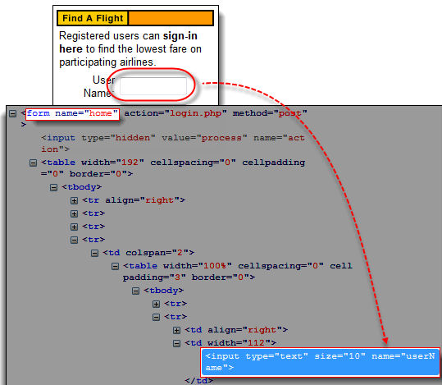
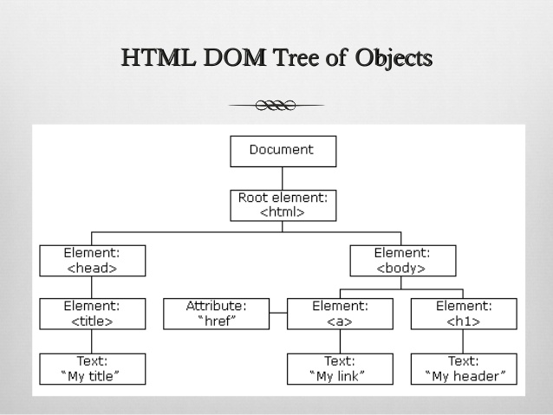
Document Object Model (DOM)
The Document Object Model (DOM), in simple terms, is the way by which HTML elements are structured.
Selenium IDE is able to use the DOM in accessing page elements.

